Slide 1
Notes on… Periodic Trends
The elements are arranged on the periodic table in a very specific and awesome way…
Certain characteristics of atoms show trends within the groups (columns) and periods (rows).
These trends are observed as a gradual increase or decrease in the value of these characteristics.

Slide 2
Periodic Trends
The trending of these characteristics is dependent on two properties of atoms:
The highest energy level that contains electrons
= each period adds another energy level around the nucleus
What is an energy level?
The number of protons and electrons in the atom
= the more protons and electrons in the atom, the stronger the attractive force

Slide 3
Periodic Trends
There are 3 characteristics of atoms
that we will study trends for:
Atom Radius (size)
Ionization Energy
Electronegativity

Slide 4
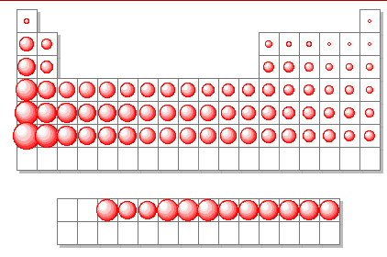
Trend #1 – Atomic Radius

Slide 5
Trend #1 – Atomic Radius
Going Down a Group
Why do atoms get bigger going down a group?

Slide 6
Trend #1 – Atomic Radius
Going Down a Group
Why do atoms get bigger going down a group?
Each period down adds another energy level around the nucleus, increasing the size of the atom

Slide 7
Trend #1 – Atomic Radius
Going Down a Group
Why do atoms get bigger going down a group?
Each period down adds another energy level around the nucleus, increasing the size of the atom
Going Across a Period
Why do atoms get smaller going left to right across a period?

Slide 8
Trend #1 – Atomic Radius
Going Down a Group
Why do atoms get bigger going down a group?
Each period down adds another energy level around the nucleus, increasing the size of the atom
Going Across a Period
Why do atoms get smaller going left to right across a period?
The number of protons increases moving across a period, increasing the attraction between the nucleus and the electrons. This attraction shrinks the atom.

Slide 9
Trend #1 – Atomic Radius *arrow points in direction of increase*

Slide 10
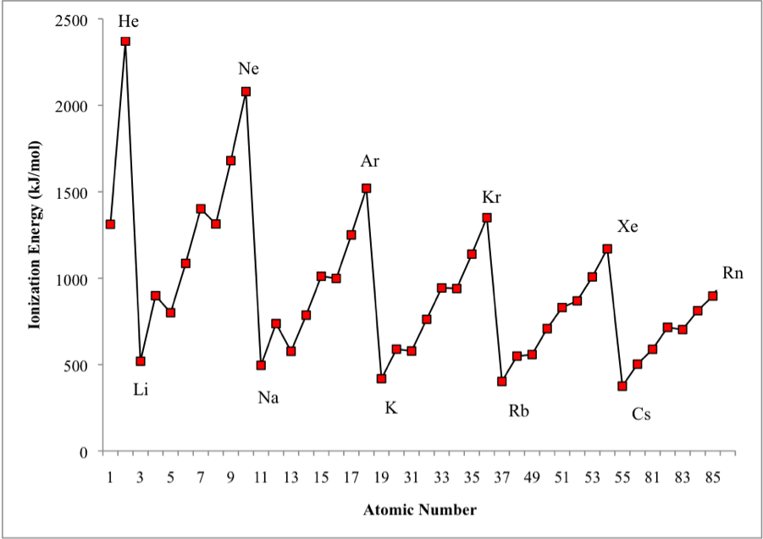
Trend #2 – Ionization Energy

Slide 11
Trend #2 – Ionization Energy
The higher the ionization energy for an atom, the harder it is to remove an electron from the atom.
The lower the ionization energy for an atom, the easier it is to remove an electron from that atom.

Slide 12
Trend #2 – Ionization Energy
Going Down a Group
Why is it easier to remove electrons from atoms further down a group?

Slide 13
Trend #2 – Ionization Energy
Going Down a Group
Why is it easier to remove electrons from atoms further down a group?
The atoms are larger and electrons are farther from the nucleus. This makes the electrons easier to remove.

Slide 14
Trend #2 – Ionization Energy
Going Down a Group
Why is it easier to remove electrons from atoms further down a group?
The atoms are larger and electrons are farther from the nucleus. This makes the electrons easier to remove.
Going Across a Period
Why is it harder to remove electrons as you move left to right across a period?

Slide 15
Trend #2 – Ionization Energy
Going Down a Group
Why is it easier to remove electrons from atoms further down a group?
The atoms are larger and electrons are farther from the nucleus. This makes the electrons easier to remove.
Going Across a Period
Why is it harder to remove electrons as you move left to right across a period?
The atoms are smaller moving right across the periodic table with electrons closer to the nucleus. This makes the electrons harder to remove.

Slide 16
Trend #2 – Ionization Energy *arrow points in direction of increase*

Slide 17
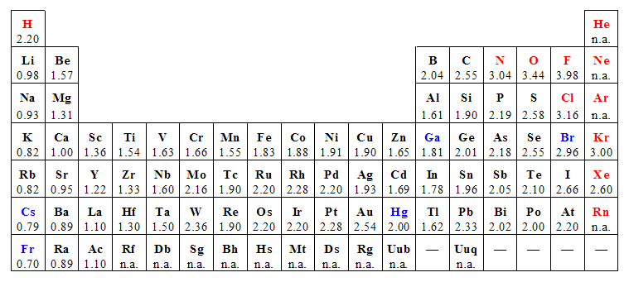
Trend #3 – Electronegativity An atoms ability to attract electrons

Slide 18
Trend #3 – Electronegativity
Going Down a Group
What is the trend for electronegativity going down a group?

Slide 19
Trend #3 – Electronegativity
Going Down a Group
What is the trend for electronegativity going down a group?
Electronegativity decreases moving down a group

Slide 20
Trend #3 – Electronegativity
Going Across a Period
What is the trend for electronegativity going right across a period?

Slide 21
Trend #3 – Electronegativity
Going Across a Period
What is the trend for electronegativity going right across a period?
Electronegativity increases moving right to left across a period.

Slide 22
Trend #3 – Electronegativity *arrow points in direction of increase*

Slide 23
Let’s use what we’ve learned
Take out your Periodic Table.
Answer the following questions:
Which element has the largest atomic size?
Li Na Be
2. Which element has the lowest ionization energy?
S Se Cl
Which element has the highest electronegativity?
C N Si

Slide 24
Let’s use what we’ve learned
Take out your Periodic Table.
Answer the following questions:
Which element has the largest atomic size?
Li Na Be
2. Which element has the lowest ionization energy?
S Se Cl
Which element has the highest electronegativity?
C N Si

